Slide 1
Character Education
Character in Action at JBS
Pastoral Matters
A.Eaton: Grade 7&8 Leader
Date: 09.02.22

Slide 2
DOING THE RIGHT THING EVEN WHEN EVERYONE ELSE IS DOING THE WRONG THING DOING THE RIGHT THING EVEN WHEN NO ONE IS WATCHING YOU

Slide 3
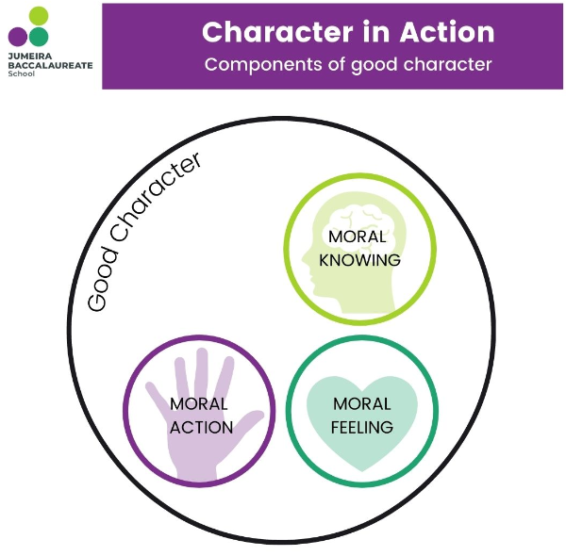
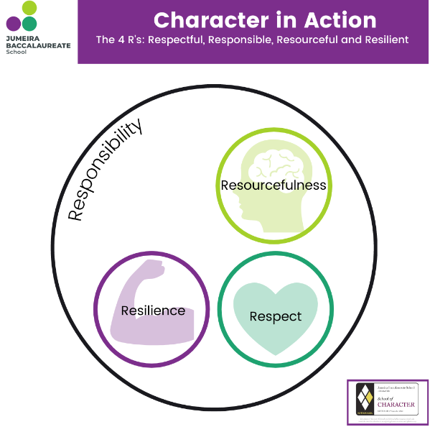
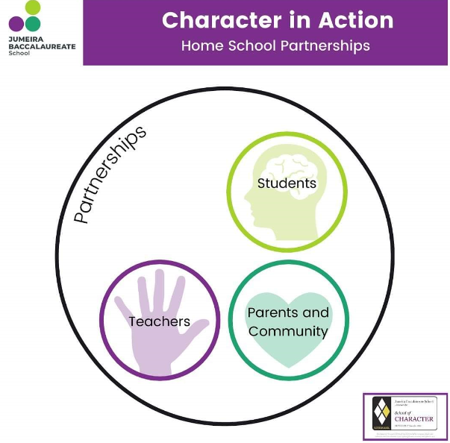

Slide 4
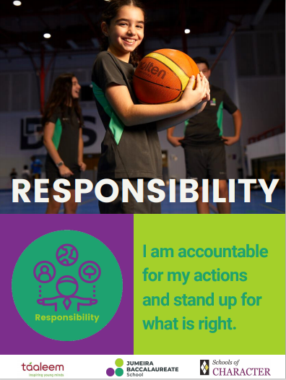
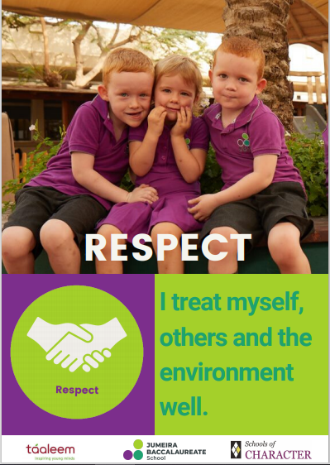

Slide 5
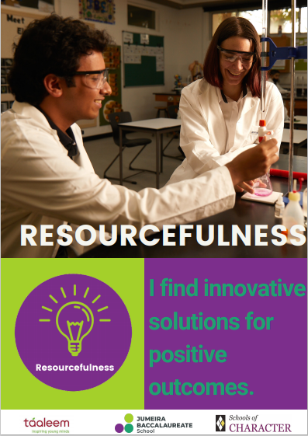

Slide 6
Character in Action Logos

Slide 7
Examples of Positive Behaviors
GOOD CHARACTER; doing the right thing when no one is looking and displaying many other good character traits or virtues;
Excellent effort
Excellent classwork
Excellent homework
Being prepared for class (the EMAN letters we have on the report)
Displaying IB learner profiles
Displaying traits of good character (including the 4 R’s)
Engagement and participation in class
Perfect punctuality and attendance

Slide 8
How we celebrate positive behavior
House points and record these on Isams for matters which are measurable (not behavior)
Verbal praise to students (1:1)
Positive emails and cc in grade leader
Certificates (e.g., IB learner award)

Slide 9
Challenging Student Behaviour

Slide 10
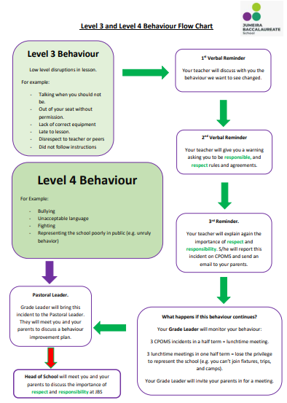
Standard procedure in lessons
First time - Benefit of the doubt, ensuring we have acknowledged and addressed the matter
Second time - Verbal Warning
Third time - Log on CPOMS and email home

Slide 11
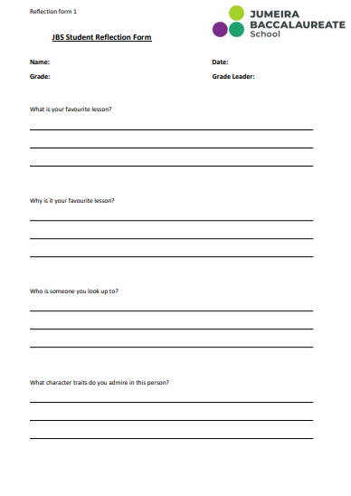
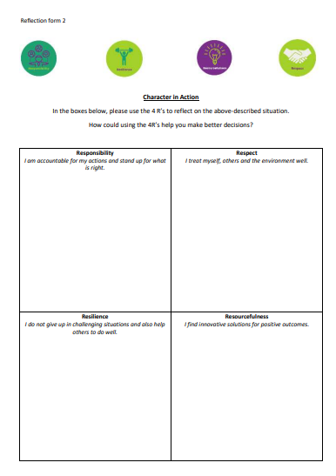

Slide 12
Parental Support is Key

Slide 13
Any Questions?

