Slide 1
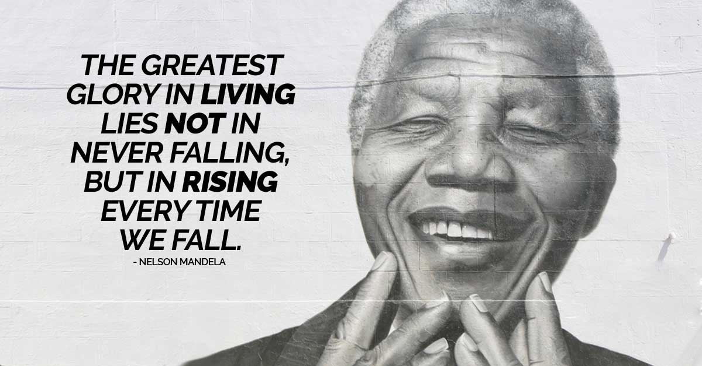
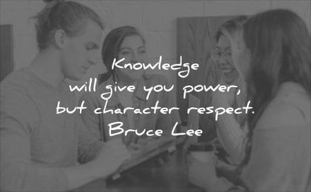

Slide 2
Leadership & Character Education at Hodge Hill Girls’ School

Slide 3
Discuss in pairs and then with your Form Group:
Can you answer the following key questions:
How do you know you are a good person?
Can you use your own initiative, or do you have to be guided/told what to do all the time?
Have you ever shown that you are a responsible/reliable person? How have you done this? Can you give examples?
What do you think other people would say about your personality? (Friends/family)
Other than your personal learning in the classroom, what do you do to learn new skills/develop your personal qualities and gain new experiences?

Slide 4
Seeing the ‘bigger picture’
Why should we try to ‘better ourselves’ and ‘be the very best we can be’?
Why do schools support pupils to be proud of themselves and encourage them to develop new skills?
Can you think of the ways in which Hodge Hill Girls’ School encourages each and every pupil to develop skills and personal qualities?
Consider how your skills and personal qualities will help you achieve your future goals.

Slide 5
Our Values at Hodge Hill Girls’ School
At Hodge Hill Girls’ School we have five very important, core values which are at the heart of all we do;
Partnerships – we value each member of our school community and work in partnership to achieve the best outcomes. ​
Respect – for ourselves and others in words and actions.​ We demonstrate respect for our environment.
Inspiration – we are inspired to make a positive difference to ourselves and the wider community within our daily lives. We are inspired to challenge ourselves and to be the very best we can.
Determination – we show determination, and we keep trying even when the going gets tough.​ We demonstrate resilience, take risks and rise to the challenge.
Excellence - we aim for excellence, demonstrating high standards in all that we do. We demonstrate a professional approach in our actions, words, attire and outcomes.​

Slide 6
Opportunities for pupils to develop essential leadership and character-building qualities
At school we pride ourselves on our core values and providing as many opportunities as possible for pupils to develop their leadership and character-building qualities.
Developing your skills and personal qualities is so important when you are making college, sixth form and university applications as well as applying for jobs in the future.
Our aim as a school is to ensure that you are all well-rounded individuals, not just academically but also in the character and personal attributes you are able to demonstrate. As such, we hope you will be well-prepared and skilled for life beyond Hodge Hill Girls’ School.

Slide 7
Opportunities at Hodge Hill Girls’ School
There are so many wonderful opportunities for you to develop your skills, character and personal qualities at Hodge Hill Girls’ School.
Alongside learning within and beyond the classroom through enrichment opportunities many girls become Prefects, School Council Representatives/House Leaders/House Captains, Peer Mentors, Sports Leaders, Environment Ambassadors…to name but a few roles we have in school!
Your Form Tutor will now present to you a new initiative we are now ready to launch – The Hodge Hill Girls’ School Leadership & Character-Building Awards.

Slide 8
Hodge Hill Girls’ School Leadership & Character-Education Awards
This is a new awards programme which will run along side our existing ClassCharts awards and school achievements.
As you work through bronze, silver & gold, you will further develop your skills, character & personal qualities, which as mentioned before, will give you fantastic evidence for future colleges, universities and employers and more importantly help you to build confidence, resilience and be the very best you can be!
Take a look now at the programme to see how you could achieve bronze, silver & gold! Please spend the remainder of this session planning what you personally will do and when. Further information will be sent to you soon via your Form Tutors and Pupil Portal about how the awards will be run and what you need to do.

