Slide 1
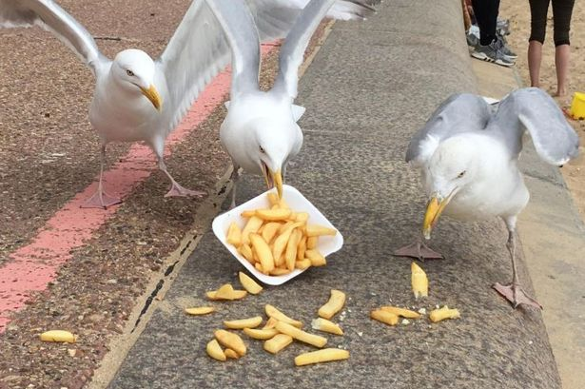
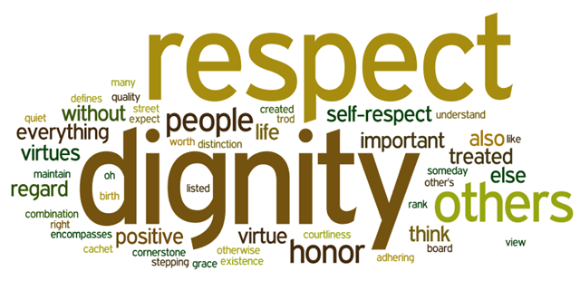
Around the school this week
TUTOR READING – ON TIME AND FOCUSED
USE THE BOOKMARKS ALL THE TIME
OUTSTANDING ENGAGEMENT IN ALL LESSONS
KEEP IT A ‘LITTER FREE’ SCHOOL – USE THE BINS

Slide 2
‘Why develop your Character?’
Mr Clyne
June 2021

Slide 3
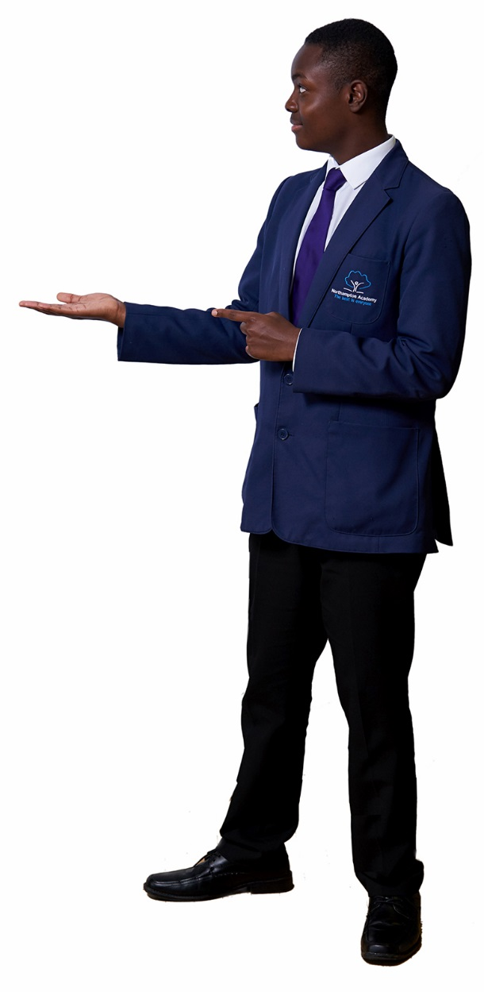
Character is a set of personal traits or dispositions that produce specific moral emotions, inform motivation and guide conduct. Character education includes all explicit and implicit educational activities that help young people develop positive personal strengths called virtues.
A person with “good character” acts, thinks, and feels in a way that matches some commonly accepted “good” traits, like being honest, respectful, responsible, caring, fair etc…

Slide 4
Civic Values | Intellectual Values | Moral Values | Performance Values
Service Neighbourliness Citizenship Community awareness Volunteering Social justice | Reflection Focus Critical thinking Reason and judgement Curiosity Resourcefulness Open-mindedness Wisdom Creativity | Courage Compassion Gratitude Justice Honesty Humility Modesty Self-discipline Tolerance Integrity Friendliness Respect Trust | Resilience Perseverance Determination Leadership Teamwork Confidence Motivation Ambition Problem-solving Communication

Slide 6
Respect
Showing due consideration for the values, opinions and beliefs of others
Understanding that we are all different from one another
Respect for ourselves, others and the environment
Determination
Not giving up, especially during adversity
Embracing the challenges of learning at a high level
Supporting each other to achieve
Ambition
Aspiring to be the best people we can possibly be; and know what this looks like
Aspiring to achieve the highest outcomes possible
Aspiring to achieve the best jobs, college and university places

Slide 7
Tolerance
Ability and willingness to accept the existence of opinions or beliefs that are different from our own
Understanding that not all situations and issues are binary
Willingness to embrace diversity of religion, race and culture
Integrity
Doing the right thing, even when nobody is watching
Being honest with yourself and others, even when in the wrong
Having strong moral principles

Slide 8
Why character?
Create a positive school culture – better behaviour
Develop good citizens – ‘flourishing individuals’
Help you build up support networks – individuals with good character tend to have more stable friendship groups
Improved employability – values are what employers are looking for
Handle pressure of school and home life
Better exam outcomes

Slide 9
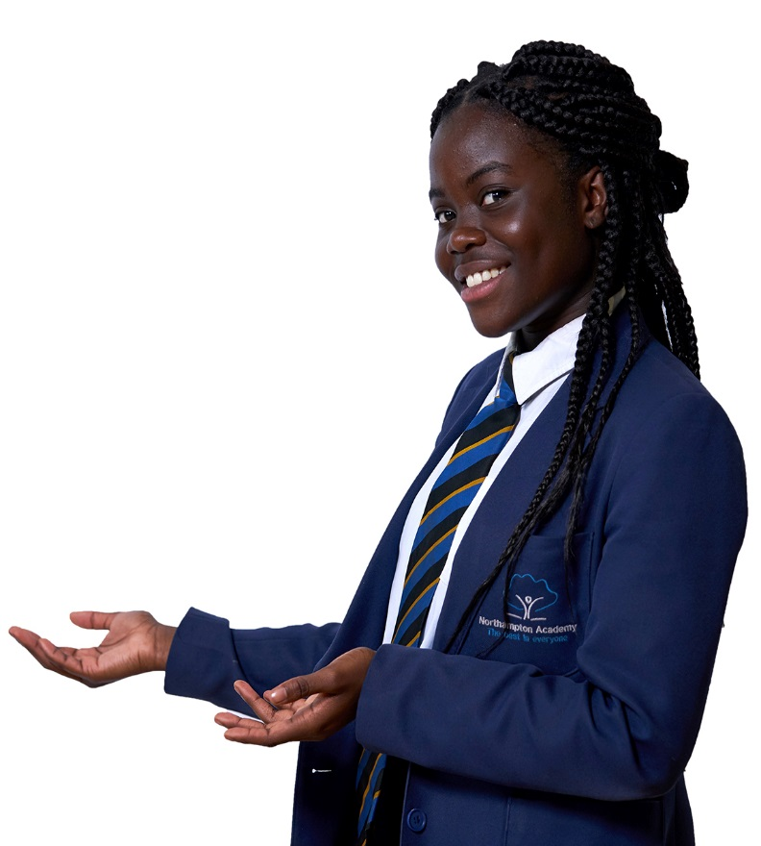
Your teacher leaves the answers to the assessement you are doing tomorrow and leaves the room. You are the only student left
What would you do and why?: A) Quickly look at the answers B) Take a picture and show friends C) Leave the classroom

Slide 10
Your teacher leaves the answers to the assessement you are doing tomorrow and leaves the room. You are the only student left
What would you do and why?: A) Quickly look at the answers B) Take a picture and show friends C) Leave the classroom – Integrity

Slide 11
You find a £5 note in the courtyard and no-one else is around
What would you do and why?:
Take the money and buy somehting in canteen
Take the money are buy your friends something
Hand the money in

Slide 12
You find a £5 note in the courtyard and no-one else is around
What would you do and why?:
Take the money and buy somehting in canteen
Take the money are buy your friends something
Hand the money in – Integrity

Slide 13
You go to get your lottery ticket and you are 50p short (ticket is £2). Your friend gives you the 50p and you end up winnning £25,000. You never discussed what would happen if you won anything.
What would you do and why?: A) Give your friend half the winnings B) Give your friend a quarter of the winnings C) Don’t tell him you won and give him nothing D) Give him his 50p back

Slide 14
You go to get your lottery ticket and you are 50p short (ticket is £2). Your friend gives you the 50p and you end up winnning £25,000. You never discussed what would happen if you won anything.
What would you do and why?: A) Give your friend half the winnings – Integrity B) Give your friend a quarter of the winnings C) Don’t tell him you won and give him nothing D) Give him his 50p back

Slide 15
‘Phronesis’

Slide 16
‘Phronesis is an ancient Greek word for a type of wisdom or intelligence relevant to practical action, implying both good judgement and excellence of character and habits.’

Slide 17
Why character?
Exclusions have dropped by 75% in last 4 years
Number of students who have had an exclusion has dropped by 73% in last 4 years
Number of students with repeated exclusions has dropped by 72% in last 4 years
Attendance has increased by 0.6% (on the back of COVID restrictions)
100% of students now know our values
Litter has decreased by 90% of previous levels
School is safer – 98% feel safe in survey compared to 88% 3 years ago

Slide 18
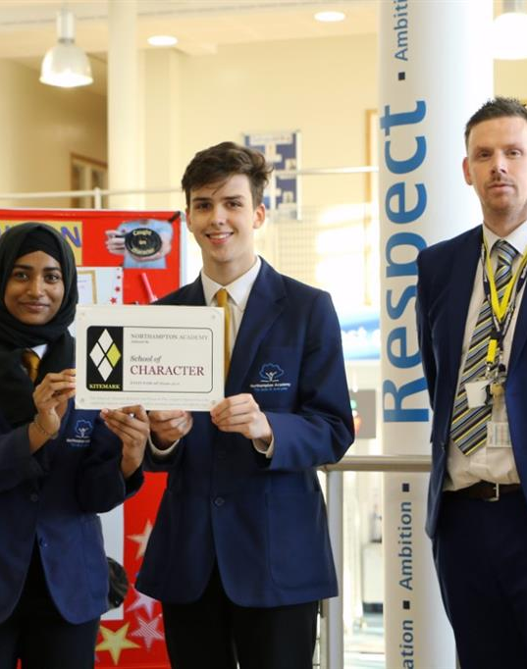
‘The school’s strongly held values of respect, determination and ambition help them to reflect on and develop their character. Character development is at the heart of the school’s work.’
‘Leaders want pupils to develop strong personal values of determination, respect and ambition. They have planned a curriculum to develop pupils’ character. Pupils demonstrate the school’s values through their excellent and thoughtful behaviours.’

Slide 19
A person with “good character” acts, thinks, and feels in a way that matches some commonly accepted “good” traits, like being honest, respectful, responsible, caring, fair etc…
What can you do to improve your own character?

