Slide 1


Character Education
Yate Academy
YATE ACADEMY
Proud to
be part
of the
A BETTER CHANCE OF SUCCESS

Slide 2
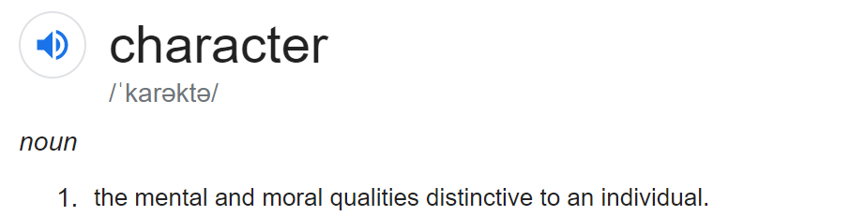

Slide 3
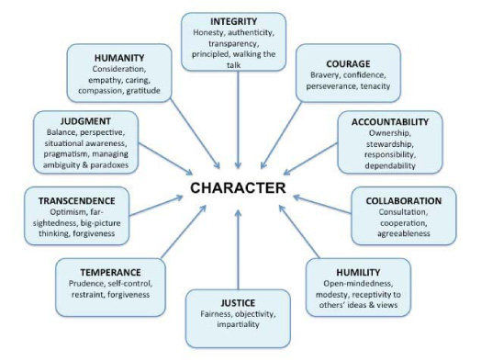

Slide 4
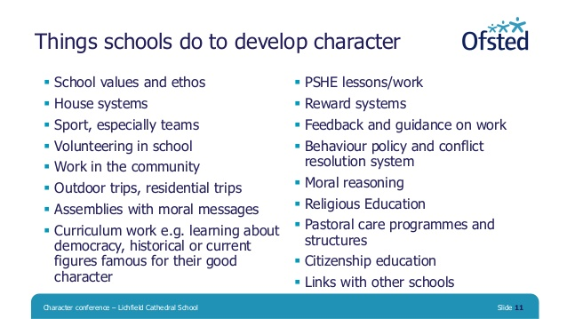


Slide 5
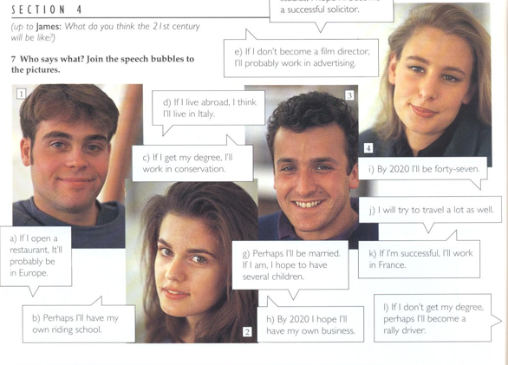
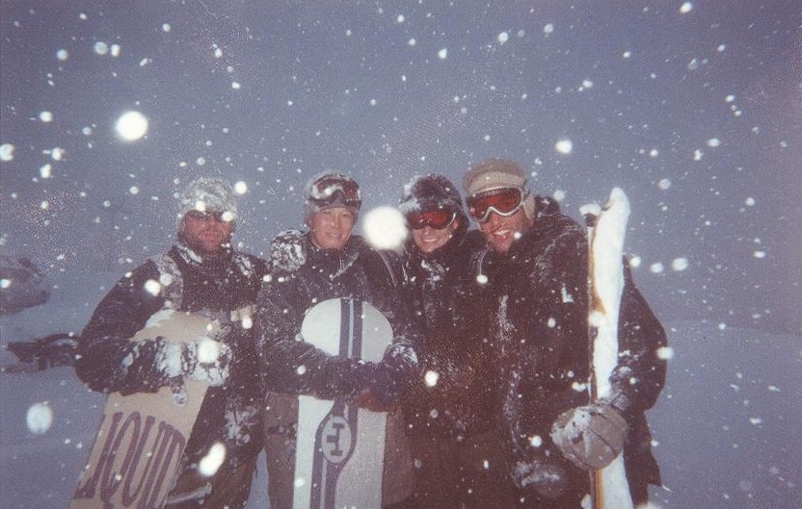
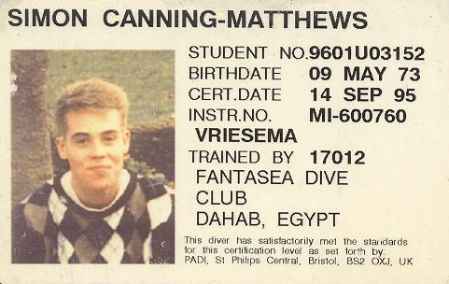
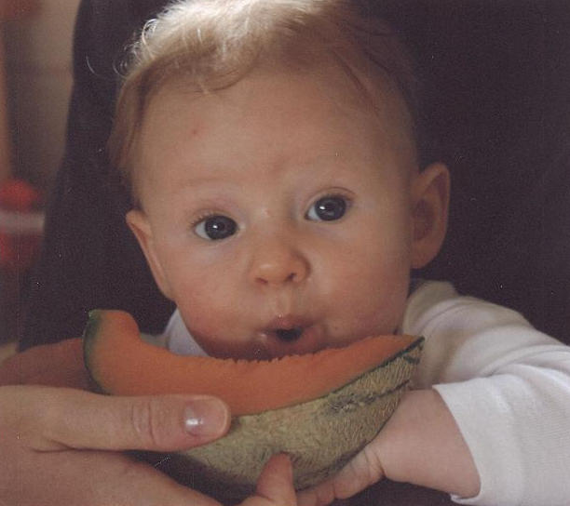
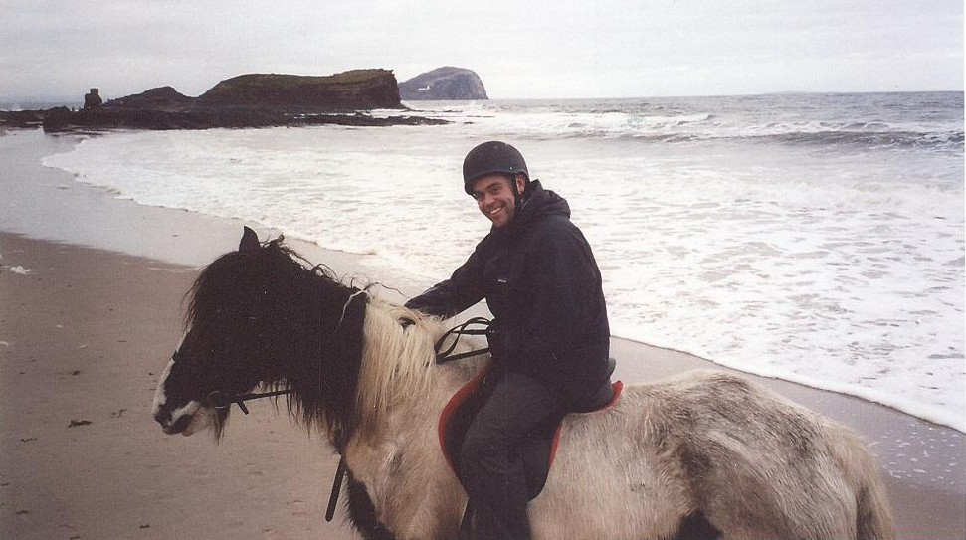
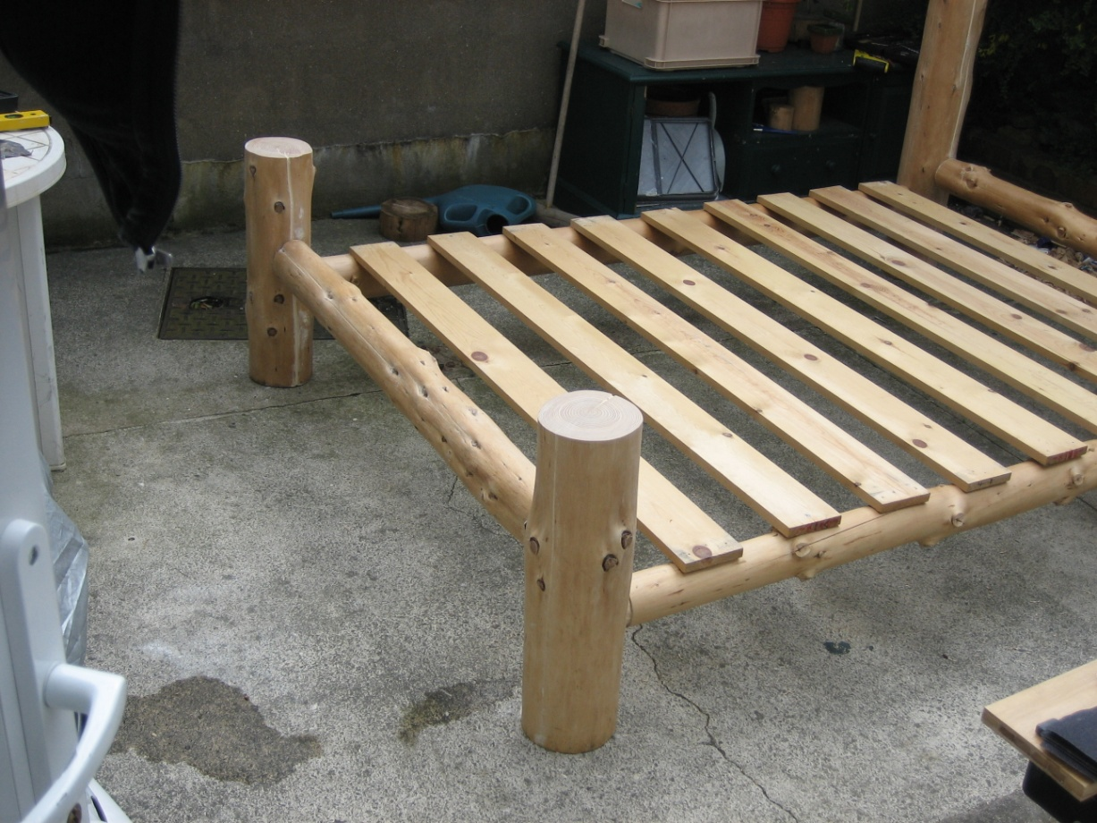
Character Building!

Slide 6
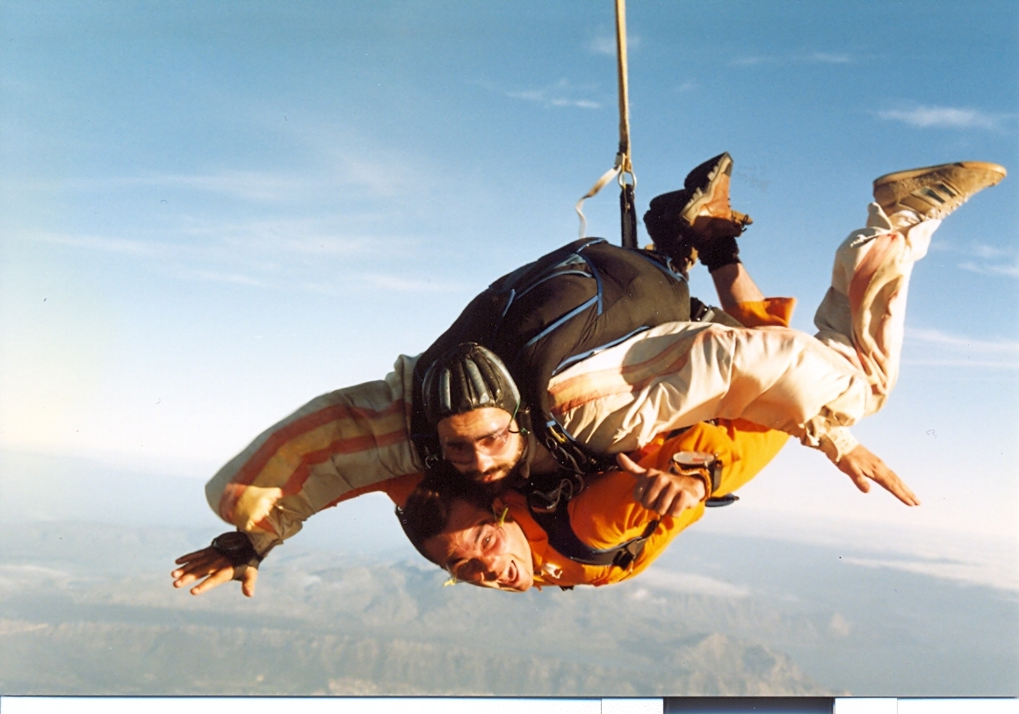
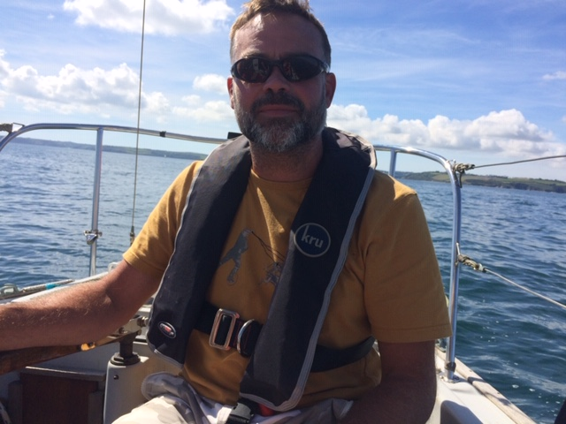
Character Building!

Slide 7
Character Intent
At Yate Academy success is not just measured by academic achievement but by the character of an individual.
Our aim is to make every child in our care the very best version of themselves through nurturing talent, channelling creativity, exposing ambition and competing for excellence.
Students at Yate will experience a rich tapestry of opportunities that will shape choices, develop pride and confidence as well as prepare students for their next steps in life.

Slide 8
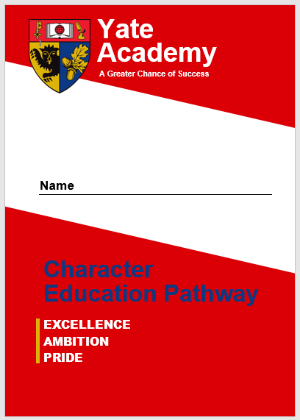
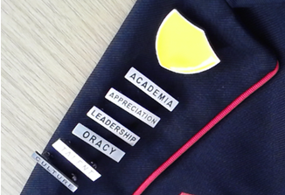
Booklet
3 Values
5 Awards per value
3 Badges per Award
Total 45 badges

Slide 9
Booklet
3 Values
5 Awards per Value
3 Badges per Award
Total 45 badges
Diverse offer
Exhibit or perform your creative talent at the school
Read 10 books from the Greenshaw Canon list
Attend 3 external Higher Academic events (Ivy League Lectures)
Take part in 1-2-1 interview with a careers advisor
Represent the school or yourself at a competitive sport
Research and Present 3 times to members of staff at Yate Academy
Be on the student council or leadership team
Complete a residential school trip
Take part in an event which improves your local environment
Visit 2 different of the following: gallery, theatre, museum, concert, ballet, opera, art cinema or similar

Slide 10
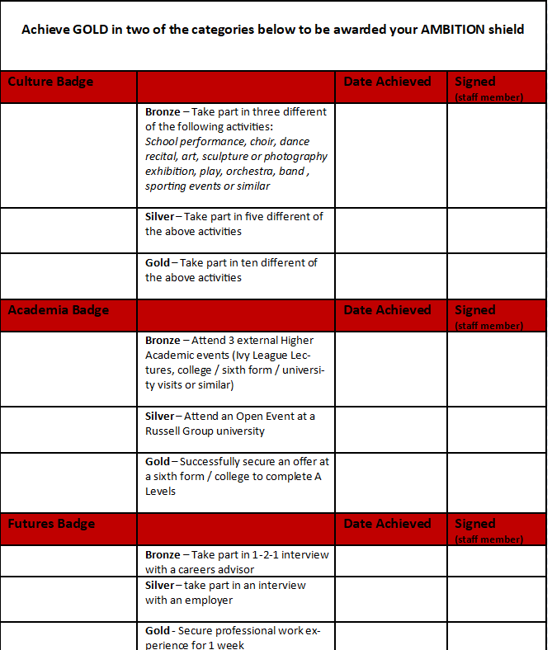
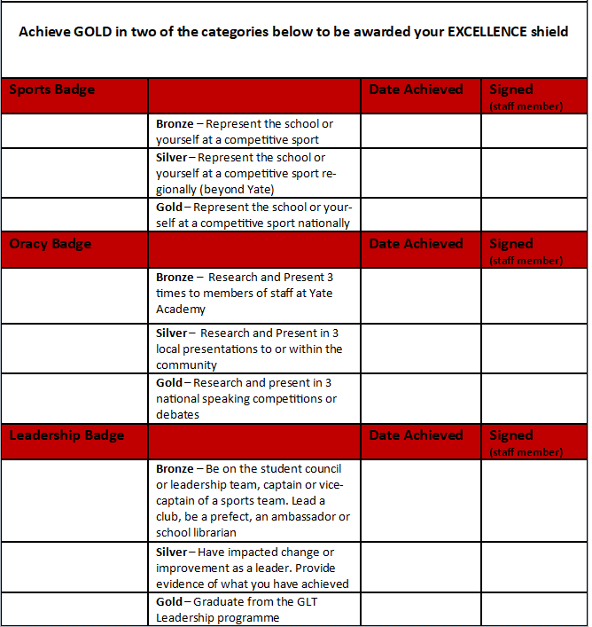

Slide 11
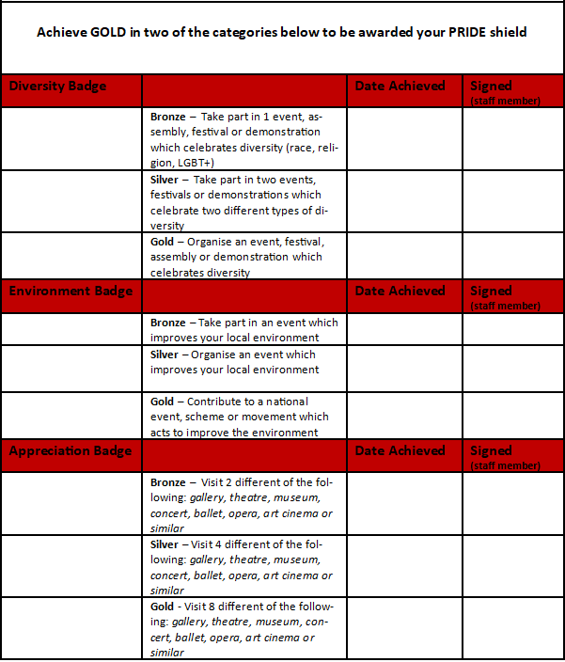

Slide 12
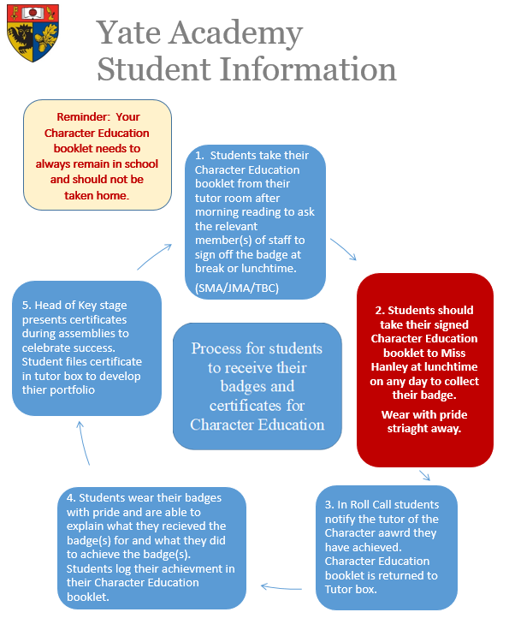
Student Process
Do an event
Get it signed off by:
Mr Matthews
Mr Maggs
Miss Weech
Go and get your badge from Miss Hanley in the Discovery centre
Celebrate your success with a certificate from Miss Beckett in an assembly
KWE

Slide 13
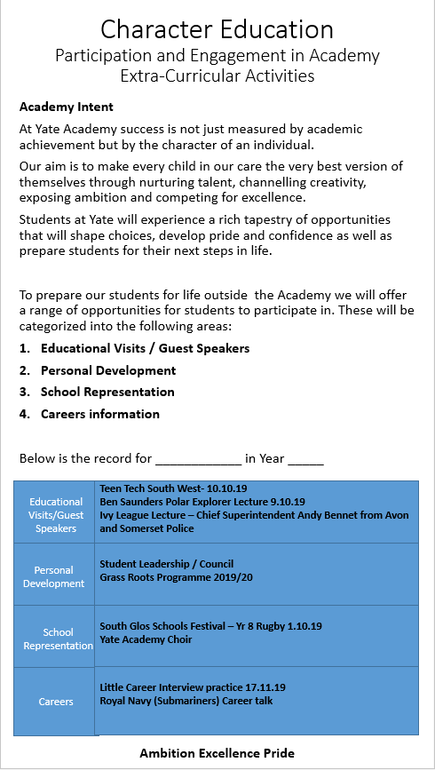
Reporting
End of Year Report
highlighting character opportunities that have been attended

Slide 14
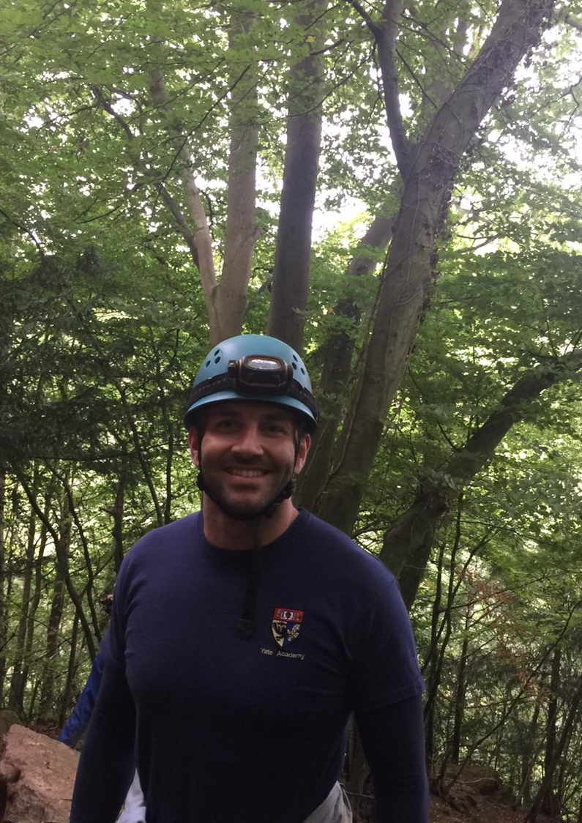
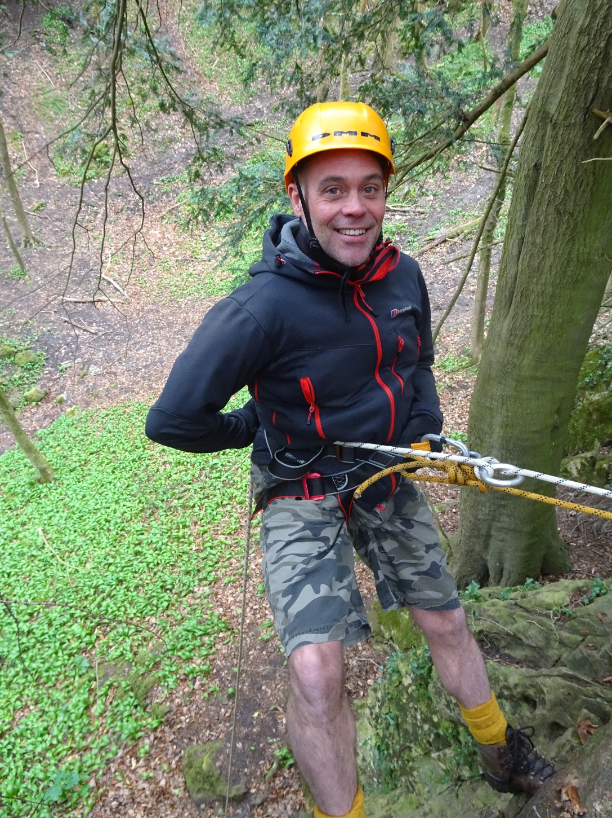

Slide 15
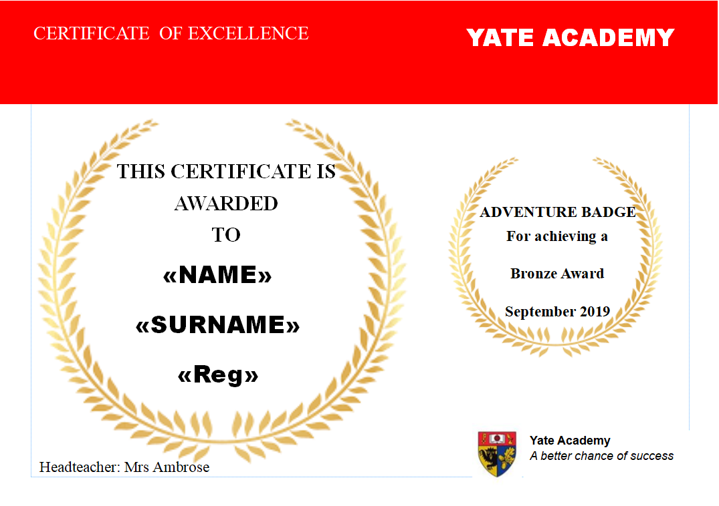
ALL GREAT CHARACTER BUILDING ACTIVITIES
Mr Maggs
Mr Matthews

Slide 16
Character Additions
Careers / Universities / Work place visits / Guest speakers
This year …….
Residential Trip
Youth 8 mentoring – Kendleshire golf course Saturdays
RAF & Marines T1 / 2
Grass Roots – T1
Crown Court - Sept 2019
Ben Saunders Polar Explorer Sept 2019
Heart Starters – Oct 2019
Road Safety presentations
Teen Tech - Oct 2019
Rotary Awards Art / 6th Form short films
Great Western Air Ambulance site visit
Chief Superintendent Andy Bennet – T2
Cambridge University – Dec 2019
Cyber Security - Dec 2019
UWE Careers – Jan 2020
Digital explorers 2020
What Career NEC March 2020
Many many more

Slide 17
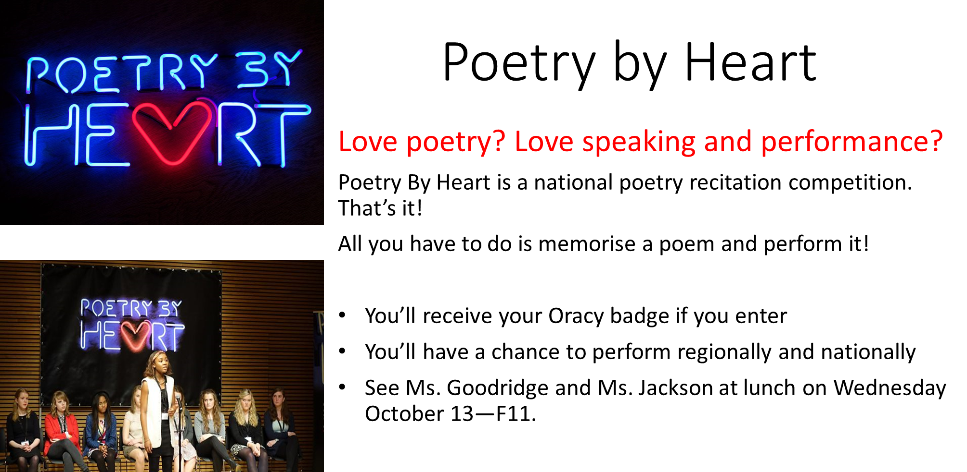

Slide 18
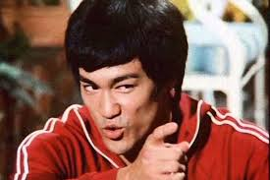
Knowledge will give you
POWER
But Character
RESPECT

