Slide 1
Careers Education
Yate Academy

Slide 2
Programme of study will follow UNIFROG
Students have had Careers opportunities each week during lock down
Dedicated career lessons each term to access and develop career language using UNIFROG
Year 9 and 10 big and little Interviews
CV preparation completed

Slide 3

Trips visits and Guest Speakers
Trips and visits are on hold until further notice – Jan 2021
Guest Speakers – are available online
Speakers for schools archive
Onsite speakers tbc

Slide 4


Character Education
Yate Academy
YATE ACADEMY
Proud to
be part
of the
A BETTER CHANCE OF SUCCESS

Slide 5
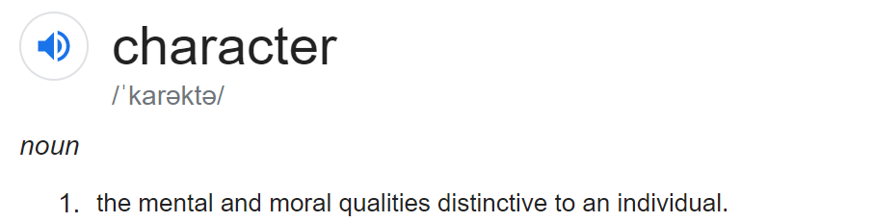

Slide 6
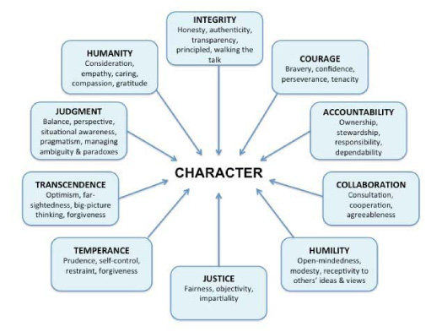

Slide 7

Character Intent
At Yate Academy success is not just measured by academic achievement but by the character of an individual.
Our aim is to make every child in our care the very best version of themselves through nurturing talent, channelling creativity, exposing ambition and competing for excellence.
Students at Yate will experience a rich tapestry of opportunities that will shape choices, develop pride and confidence as well as prepare students for their next steps in life.

Slide 8
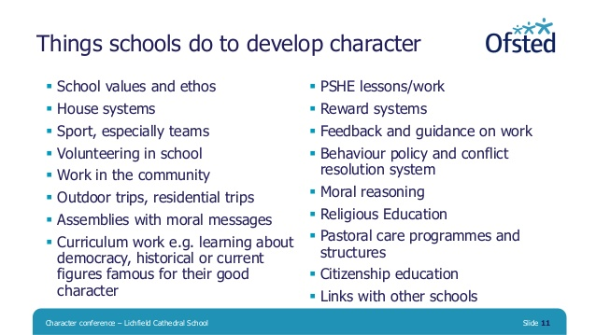

Slide 9
Booklet
3 Values
5 Awards per Value
3 Badges per Award
Total 45 badges
Diverse offer
Exhibit or perform your creative talent at the school
Read 10 books from the Greenshaw Canon list
Attend 3 external Higher Academic events (Ivy League Lectures)
Take part in 1-2-1 interview with a careers advisor
Represent the school or yourself at a competitive sport
Research and Present 3 times to members of staff at Yate Academy
Be on the student council or leadership team
Complete a residential school trip
Take part in an event which improves your local environment
Visit 2 different of the following: gallery, theatre, museum, concert, ballet, opera, art cinema or similar

Slide 10
Student Process
Do an event
Get it signed off by any teacher
Who submits a Google form (tbc)
TKI/SMA/KWE will access and confirm
Get your badge from the Discovery centre
Celebrate your success with a certificate in an assembly

Slide 11
Character Priority
Every student is able to reflect, record and confidently articulate their experiences, that result in all students achieving a wide range of character awards.

Slide 12

Highlight the Character Traits you have accessed in the lesson
Adaptive – Willing to change in response to circumstances.
Alert – Clear-thinking and intellectually active.
Ambitious – Having desire and determination to achieve success.
Attentive – Showing careful attention to the comfort or wishes of others.
Charitable – Kind and tolerant in judging others.
Compassionate – Showing sympathy and concern for others.
Confident – Certain in one’s worth, abilities and qualities.
Considerate – Showing careful thought not to inconvenience or harm others.
Cooperative – Complying readily with requests to achieve mutual ends.
Courageous – Able to do things that one fears.
Curious – Showing a strong desire to know or learn new things.
Diligent – Working carefully and persistently.
Encouraging – Giving others support, confidence or hope.
Flexible – Ready and able to adapt to different circumstances.
Forgiving – Feeling no anger or resentment to offences or mistakes.
Independent – Thinking and acting for oneself.
Kind – Being friendly, generous, and considerate
Liberal – Respecting behaviour and opinions different from one’s own.
Listening – Take notice of and make an effort to hear others.
Methodical – Orderly and systematic in thought or behaviour.
Mindful – Conscious and aware of the present moment.
Persistent – Continuing firmly despite difficulty or opposition.
Polite – Acting respectfully and considerately.
Purposeful – Showing determination or resolve.
Reasonable – Having sound judgement; fair and sensible.
Reliable – Consistently good in quality or performance.
Respectful – Showing regard for the feelings, wishes or rights of others.
Self-controlled – Managing emotions and desires well in difficult situations.
Supportive – Providing encouragement or emotional help to others.
Truthful– Telling or expressing the truth; honest.

Slide 13
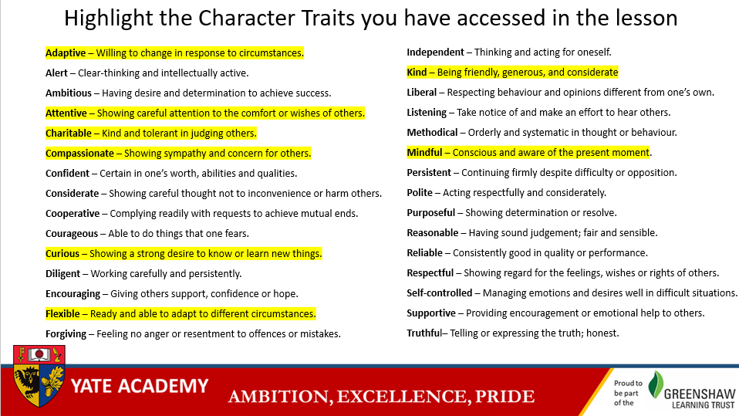
PSHE Lessons
Character reflection for each end of lesson
Part of the PSHE booklet

Slide 14

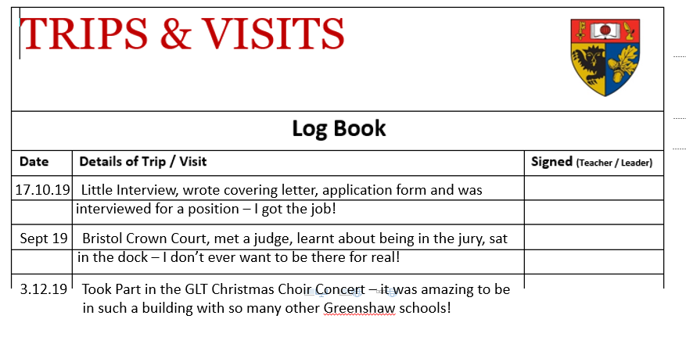
1 dedicated character lesson per term
To provide time and space for reflection on character development
Filling out Character Booklet using generated report of activities undertaken
Scaffolding of the language of character

Slide 15

Relaunch / raise character profile
COVID 19 Badge

Slide 16



Slide 17
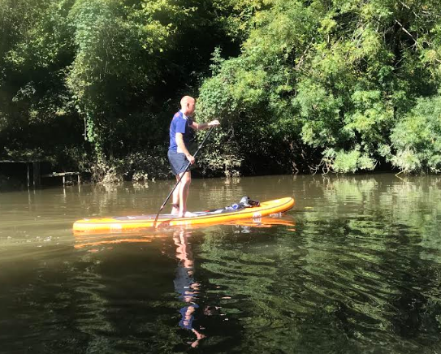
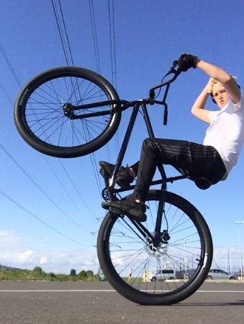
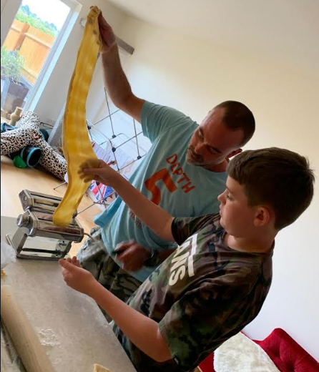
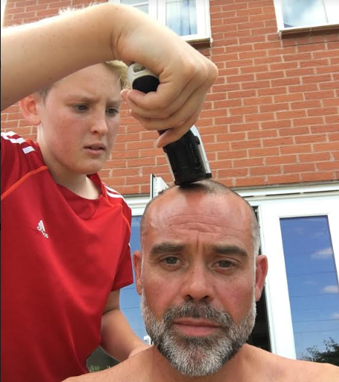

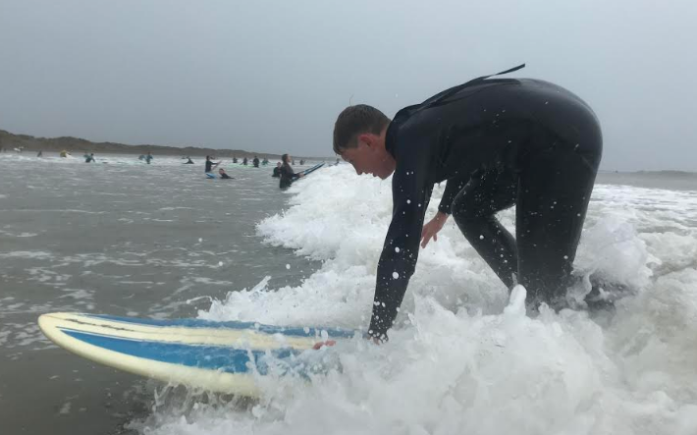
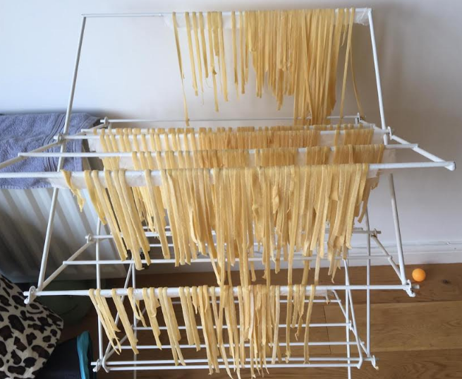
Character Building!

Slide 18
1st Character Lesson
Students revisit the character booklet
Back fill activities from last year using the report
Write a short overview of one or more positive experiences from the past 5 months
This will then be collated and COVID Badges Awarded

Slide 19
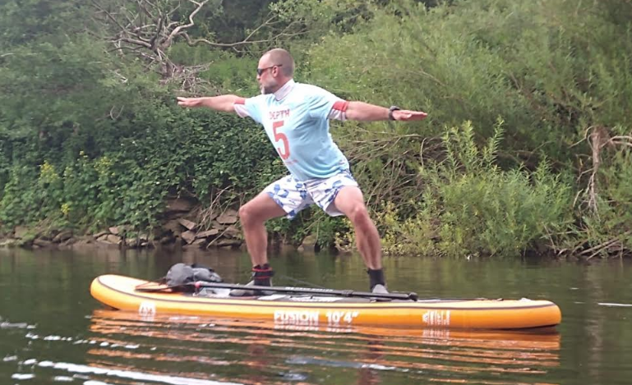
For this 1st lessons preparation
I would like each teacher to Model/Scaffold
Using their own positive example

Slide 20

Online Pilates for staff is available via zoom
If you are interested please have a chat with me

Slide 21
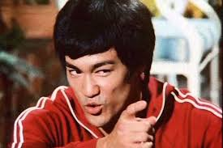
Knowledge will give you
POWER
But Character
RESPECT

