Slide 1
What is the point of school?
Why do we do what we do?
Rebecca Moors-Assistant Headteacher

Slide 2
Character Education
Insert school picture of students
What does it mean?
What do we want our students to leave school with? What kind of people do we want them to be?
Why is this important, is it even our job?

Slide 3
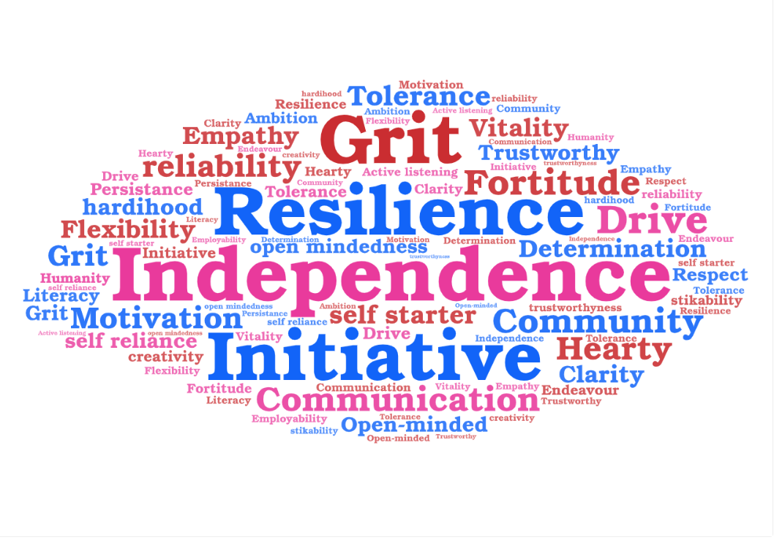

Slide 4
What Character traits do you think are the most important?
In your break out groups, identify what character traits you feel are the most important.
Note down all the ‘Character traits’ you collectively identify and then-as a group, agree the 5 that you would prioritise and feel are the most important.
Why did you make these decisions?
10 mins to complete this task-take your time.

Slide 5
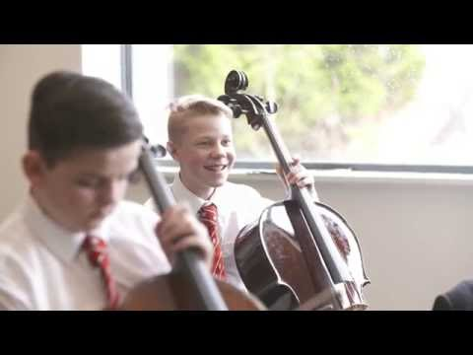
Notes:
https://www.youtube.com/watch?v=w6I6zNiH1-w

Slide 6
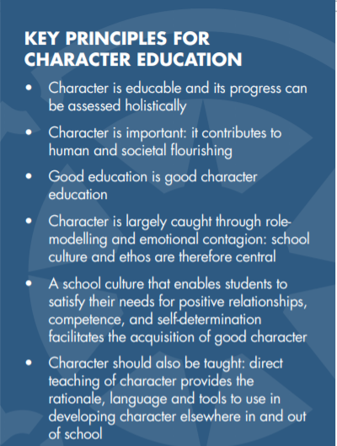
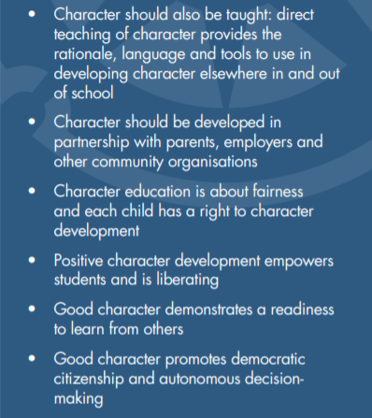
Framework For Character Education-Jubilee Centre

Slide 7
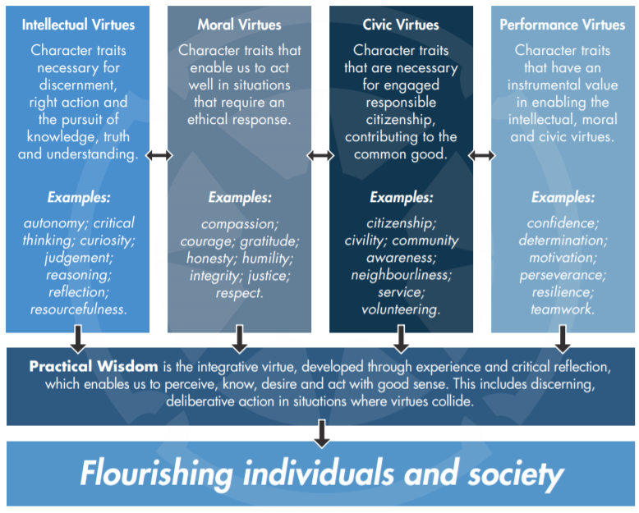
The Building Blocks of Character- Framework for Character Education.

Slide 8
Virtue Literacy
‘Schools need to provide opportunities for children to exercise the virtues in practice as well as encourage a rich discourse of virtue language, understanding and reasoning.’-Framework for Character Education Jubilee Centre
Virtue Perception
Lorem 2
Virtue Knowledge and Perception
Lorem 3
Lorem 1
Virtue Reasoning
Noticing situations that require a charactorful approach. Being self aware enough to understand that a person's actions are important in a given situation and therefore there is a ‘right’ way to behave
This involves acquiring a board and complex vocabulary linked to characterful approaches. This involves not only an understanding that something needs some action or behavioural change, but the ability to communicate what that might be
The action and understanding. This involves making a reasoned judgement which involves the ability to explain the differences in moral situations. The judgement should be reflective.

Slide 9
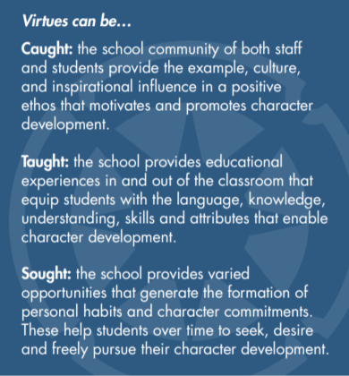
Character in our schools
What opportunities or experiences are there available in your school experience for:
Taught
Sought
Caught
You have 10 mins in your break out room to discuss this together.

Slide 10
The role of a teacher
Read the document and take some time to digest the information,
We will come back in 30 mins, in which I would like you to read the document and identify something that stood out to you as a poignant message, or a way to impact practice, or something of interest.
We will feedback together.
https://www.jubileecentre.ac.uk/userfiles/jubileecentre/pdf/character-education/Statement_on_Teacher_Education_and_Character_Education.pdf

Slide 11
Character Education
Go back to the 5 character traits that you identified in your group.
Using a scheme of work, curriculum map or topic that you are working on,
Spend some time considering how this could incorporate these curriculum traits into your day to day lessons.
I will give you 15 minutes to consider this on your own, and the 5 mins to feed back in your break out rooms
We will then discuss as a group.

Slide 12
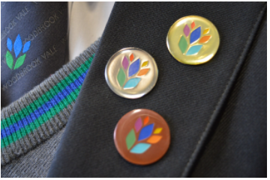
Character Education in Practice
Insert image of student leaders/character based activity

Slide 13
Further Reading
https://www.jubileecentre.ac.uk/userfiles/jubileecentre/pdf/character-education/Framework%20for%20Character%20Education.pdf Framework for Charactor Education
https://www.jubileecentre.ac.uk/userfiles/jubileecentre/pdf/TeachingCharacterThroughSubjects/Teaching_Character_Through_Subjects_2016.pdf Teaching Charactor Education through subjects
https://www.jubileecentre.ac.uk/-further teaching resources, papers to read and Character theory
https://character-education.org.uk/ Association for Character Education
Taught not Caught Educating for 21st Century-Nicky Morgan
Thrive How to cultivate Character so children can flourish online-Dr Tom Harrison

