Slide 1
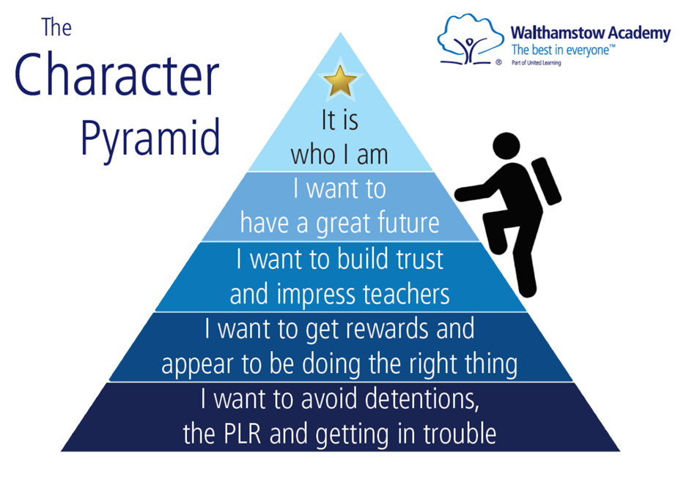
Character and Conduct in our COVID safe school
An update on our students’ conduct since the start of term
A further exploration of some of the key parts of our behaviour policy

Slide 2
How have Walthamstow Academy students shown good character since returning?
There has been a general acceptance of new routines, with an understanding that the school is doing its best to keep everyone safe.
Year group detentions have been well attended (thanks to you).
There have been low numbers of students late to school.
Behaviour in lessons has been generally very good, with rare instances of disruption.
Sanctions and rewards have been recorded properly on SIMS.
Boys have received their fair share of P1s and P2s

Slide 3
What are our priorities?
Students have been very noisy when going to and from lunch and break – this has disturbed other lessons and shown a lack of respect for the learning of others.
Students have needed constant reminders to walk quickly and quietly on the left of corridors.
There have been instances of students arguing with staff or ignoring them when they are given a sanction.
Members of the local community have been concerned that many Academy students have not worn masks in local shops or socially distanced from others.

Slide 4
Issuing rewards to students
P1s. When? How?
P2s. When? How?
P3s. When? How?

Slide 5
Issuing sanctions to students
Warnings. When? How?
Centralised detentions. When? How?
PLR. When? How?
Special COVID sanctions. When? How?
Refer students to the Character Journal if any discussion has to be entered into

Slide 6
Respect points
Boards updated once every two weeks.
As a tutor, this data is available to you at any time.
The power of this system is in the ‘buzz’ created around school. Let’s make sure we help create that.

Slide 7
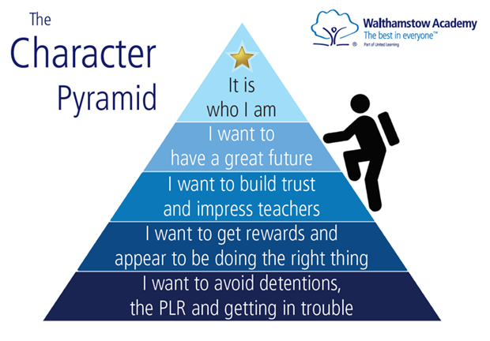
The language of the values and the pyramid
Use the language contained within the sanction codes themselves – these are there to guide you and students.
The pyramid is a powerful way to remind students about the key to good behaviour – self regulation

Slide 8
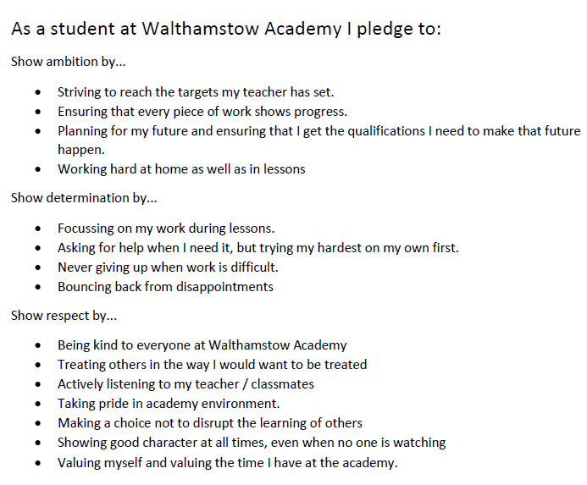
Morning tutor time this week
The student pledge and a review of their own behaviour

Slide 9
So what needs to change? 1) Break and lunch times
From next week you will be required to be silent in the corridor during break and lunchtimes. This week, we will remind you, we will ask you and we will say “shush”. From next week, all staff will immediately issue a detention if you talk in the corridors on the way to or from break or lunch.
At lunchtime, the following rules must be followed:
Stay in your seat unless getting your lunch, putting away your tray or going to the toilet.
Always clear your tray and any litter away properly.
Fall absolutely silent when the whistle goes at the end of lunchtime.

Slide 10
So what needs to change? 2) Arguing about sanctions
Look at page 39 of the Character Journal, read through the section called ‘What should I do if I think a sanction is unfair’
If you fail to follow this guidance by arguing, by answering back or by refusing to go to the PLR, you will escalate the situation.
If the sanction was going to be a warning or detention, it will now be the PLR
If the sanction was going to be the PLR, it will now be an exclusion.
If you fail to follow the instructions in the Character Journal then the sanction will be escalated immediately.

Slide 11
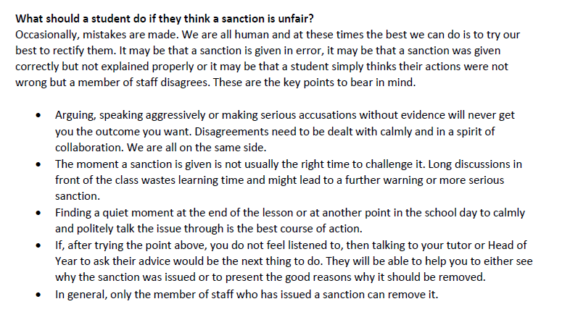
So what needs to change? 2) Arguing about sanctions

Slide 12
So what needs to change? 3) Behaviour in the community
You must wear a mask in shops, as we discussed yesterday. It is your duty to stop the spread of COVID 19
You must make every possible effort to socially distance from each other and particularly from members of the public.
You must not steal from shops. We have excluded two students this term for stealing from the co op. They send us CCTV each time it happens.
These are basic requirements. You should be doing much more than this. You should be showing good character by being polite and helpful to members of the community.

Slide 13
Final points
Familiarise yourself fully with our behaviour handbook
Issue sanctions and rewards with warmth and conviction.
Let’s work as a team to improve corridor behaviour – particularly during periods 2 and 4
Let’s work together to eliminate arguing about sanctions – use the language of ‘escalation’.
Let’s make respect boards a central feature of Academy life

