Slide 1

Empathy
What? Why? How?

Slide 2




Creative Childcare
An ad hoc and part-time creative childcare service, designed to fire up your children’s passions and interests.
Life Skills Courses
A range of exciting courses and programmes, focused on developing the soft skills that help prepare children for 21st century life.
Residential Life Skills Courses
A unique residential programme in the UK, focused on developing the soft skills that help prepare children for 21st century life.

Slide 3
Role Models
Our aim: to inspire a generation of children to become the very best they can be through their relationships, their well-being and their own sense of purpose.
communicate well
collaborate effectively
think critically
solve problems creatively
lead brilliantly

Slide 4
Empathy- what is it?
Empathy
connection
sensitivity
understanding
awareness
compassion

Slide 5
think & feel
hear
see
say & do

Slide 6
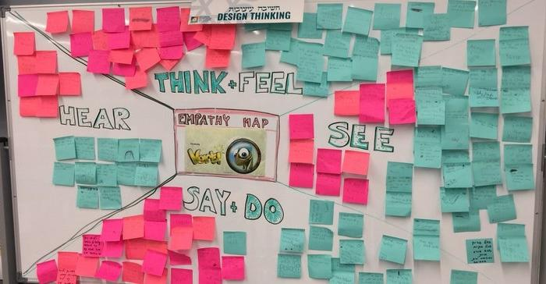
Empathy Map

Slide 7
Empathy- how can we cultivate it?
Let’s not over complicate
An approach
Empathetic listening
Questioning
Feel with it rather than deal with it
Pause points (as teachers, parents, children)

Slide 8

30 seconds making/instructing time
CAN NOT SAY
aeroplane
wings
fly

Slide 9
Empathy- how can we cultivate it?
Books, theatre, movies, experiences
Limit screen time!
Help build their self image
Chess/board games (perspective taking)
Model empathetic skills and approach
What did you do today that you feel good about?

Slide 10
Empathy- why is it important?
Develops tolerance and understanding
Underpins kindness
Accepting diversity and difference
Working together/leadership
Emotional intelligence
As teachers and educators?

Slide 11
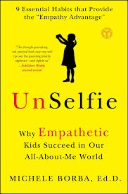


Slide 12

Call to action
1 thing you will do/consider on a personal level
1 thing you will do/promote within your class
1 person you plan to share this learning with

Slide 13
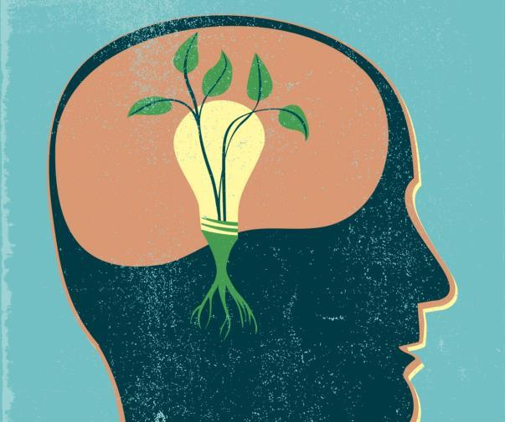
www.rolemodels.me
Active learning… Ambitious content… Serious fun!

