Slide 3
At some point, almost every child, youth and adult feels parched for meaningful recognition...

Slide 4
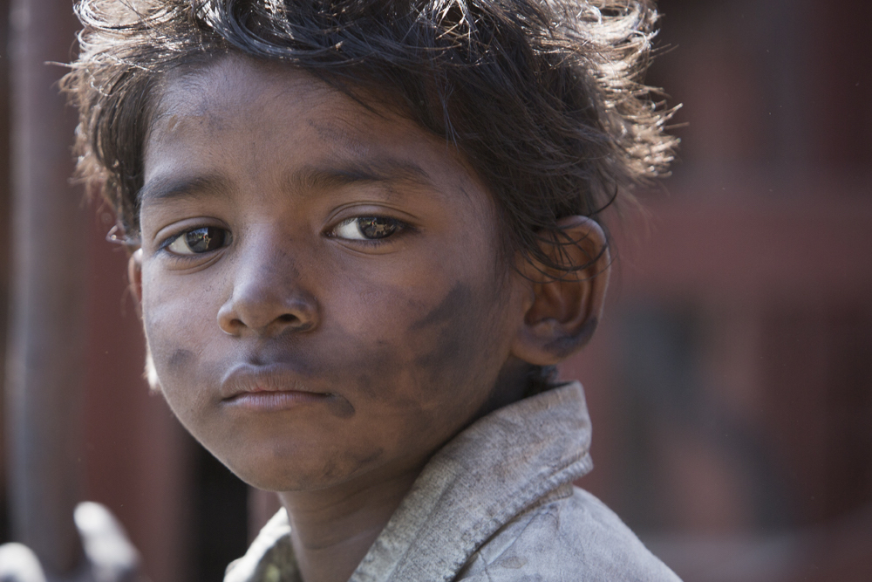

Slide 5
By identifying a virtue in a child and naming it, you will see their eyes light up in recognition – of their own value.

Slide 6
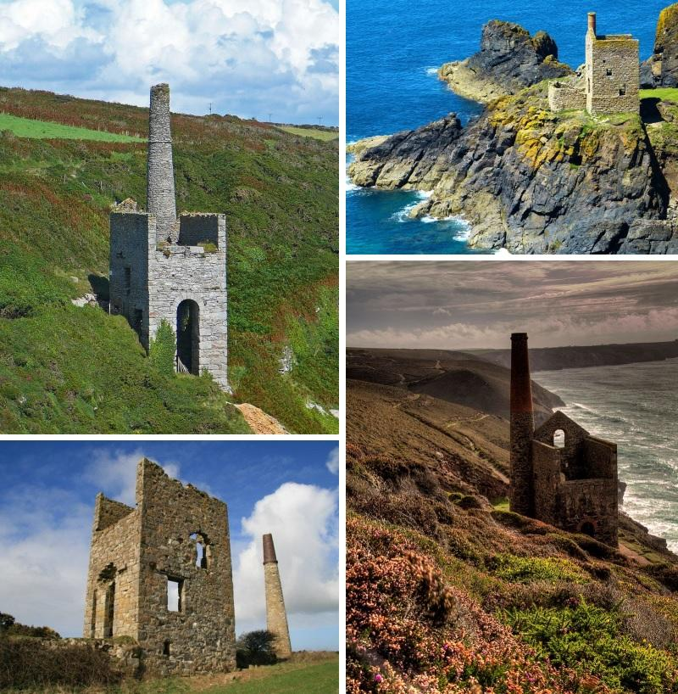

Slide 7
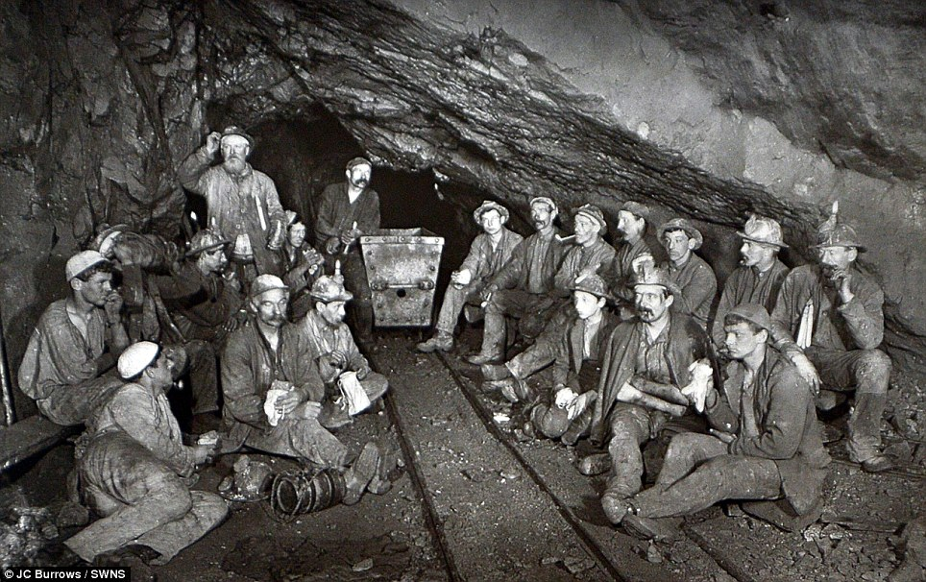
Mining for Gems

Slide 8
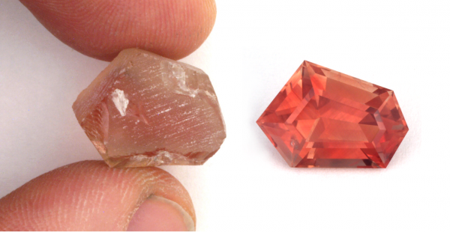
Unpolished Gem

Slide 9
Polished Gem

Slide 10
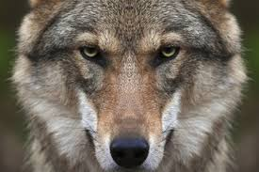
Wolf

Slide 11
Wolf
Aggression

Slide 12
Wolf
Aggression
Cunning

Slide 13
Wolf
Aggression
Cunning
Pack Mentality

Slide 14
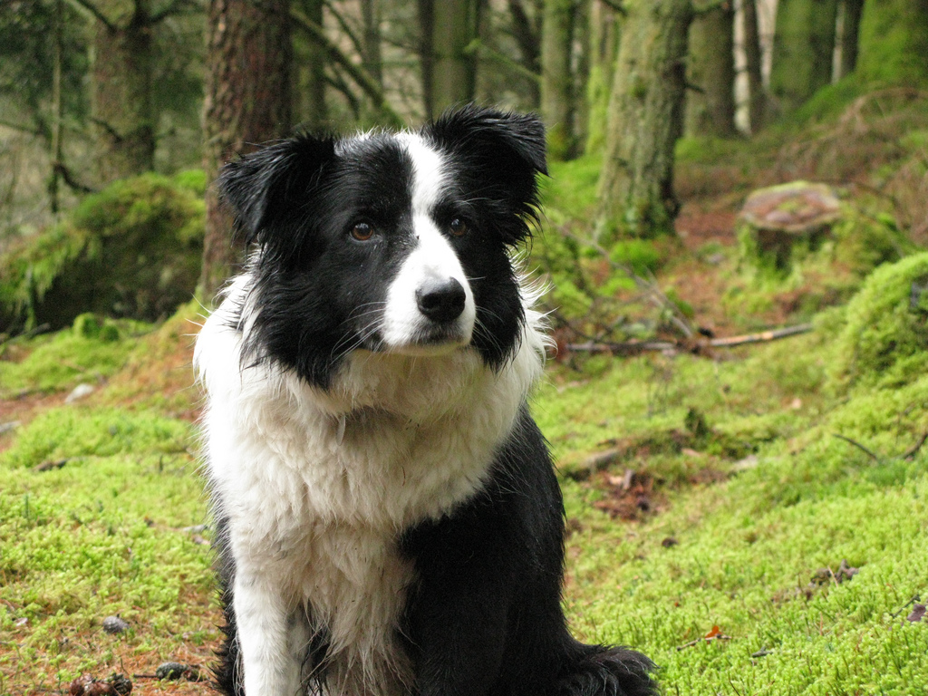
Courage Intelligence Loyalty

Slide 15
resilience, confidence and independence –
responsibility, respect
sensitivity, empathy , kindness

Slide 17
Reckless
Cowardly

Slide 18
Cowardly
Reckless
Courageous

Slide 19
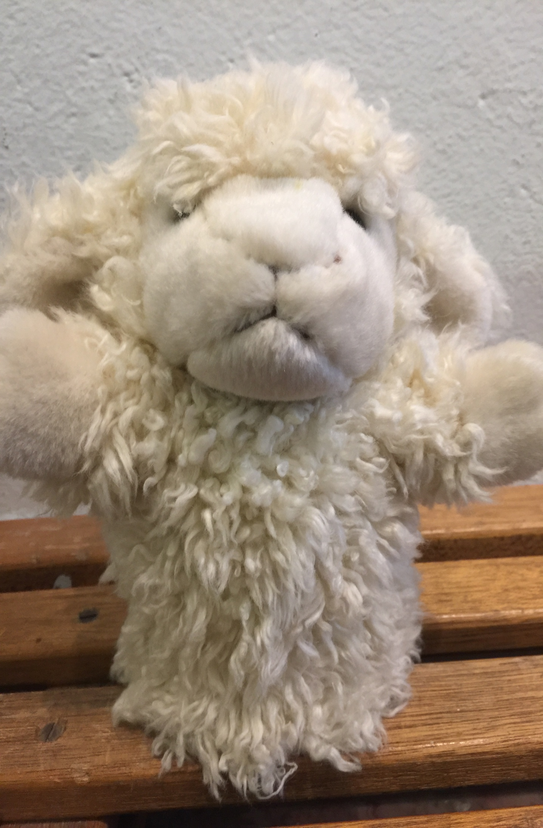
Uniformity
Isolation

Slide 20
Unity
Uniformity
Isolation

Slide 21
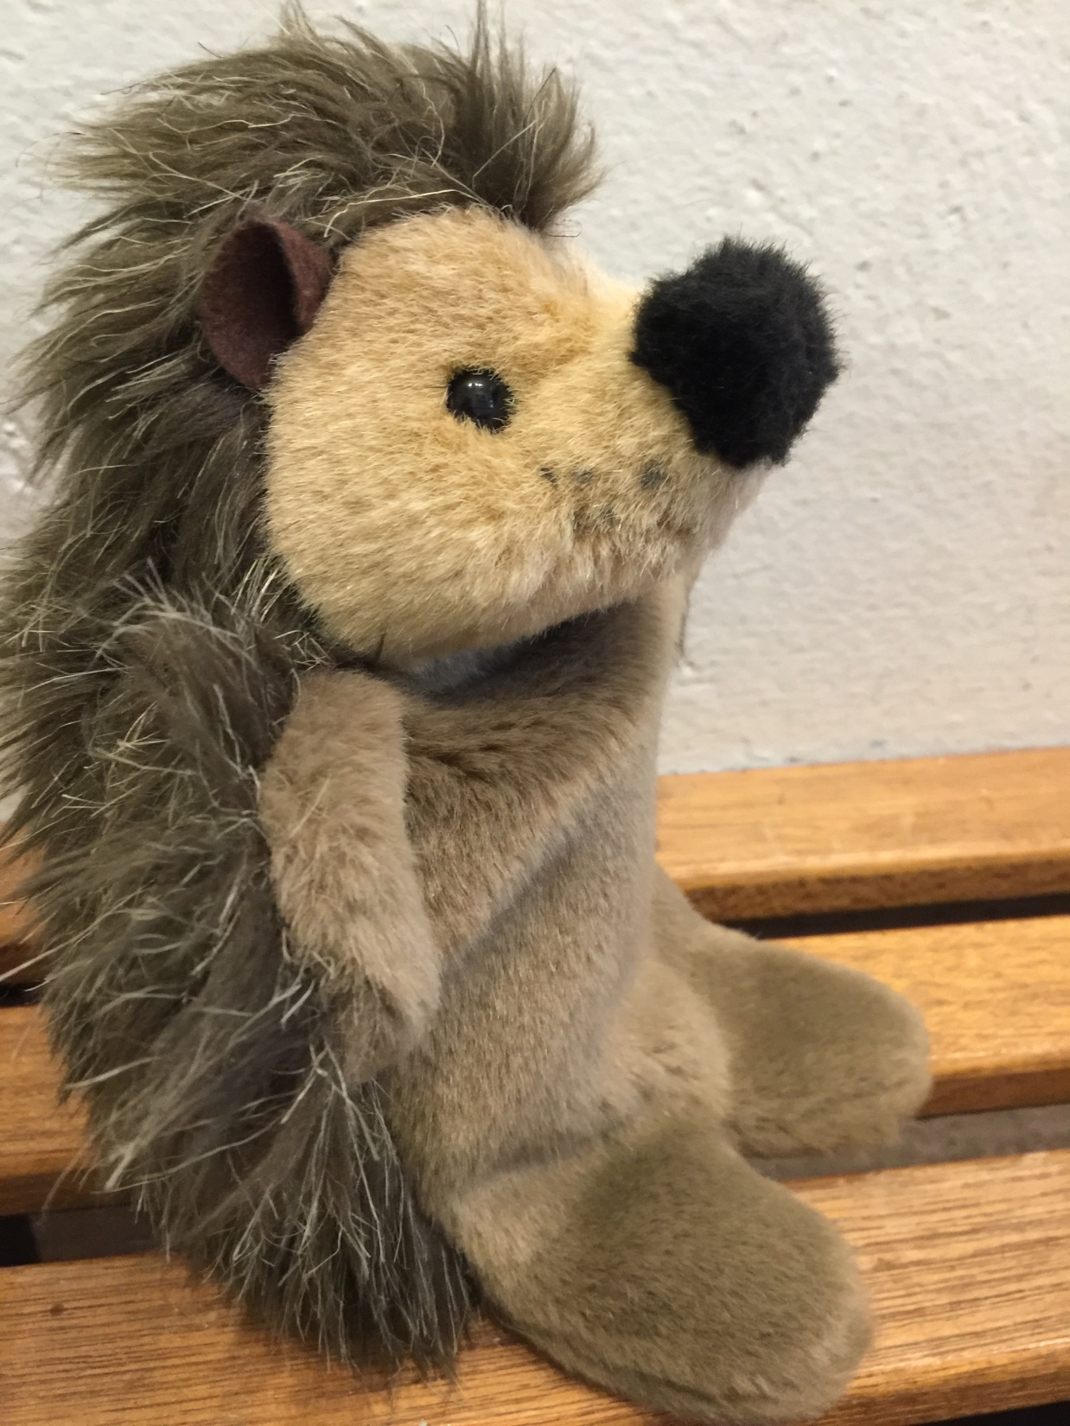
Uncaring
Prickly

Slide 22
Sensitivity Empathy
Prickly
Uncaring

Slide 23
Language shapes our character.
The way we speak has the power to discourage or to inspire.

Slide 24
Speak the Language of Virtue

Slide 25
Guide

Slide 26
Acknowledge
(Praise or Thank)

Slide 27
Correct

Slide 28
OFSTED INSPECTION FRAMEWORK 2019
Character Development
Inspectors will make a judgement on the personal development of learners by evaluating the extent to which:
The curriculum and the provider’s wider work support learners to develop their character – including their resilience, confidence and independence –at each stage of education, the provider prepares learners for future success in their next steps equipping them to be responsible, respectful, active citizens who contribute positively to society −

Slide 35
Speaking the language of virtue: Patience
Reception
Guidance:
Remember to be patient, don’t rush or overtake!
Praise
You are waiting so patiently, well done! Thank you for being patient and waiting for me to pick you,
Correction:
Don’t call out, let me see who is practising patience.
Year1 & 2
Guidance: Be patient , it will soon be your turn to speak. Please wait patiently, your turn will come.
Praise: I can see your patience because you are not interrupting or talking.
I’m going to pick you for this activity because I can see your patience in the way you are sitting and listening
Correction: Can you remember what a patient listener looks like?
Please be patient with your friends rather than getting cross with them.
Go back to the beginning and show me how patient you can be by walking calmly.

Slide 36
Year 4,5 & 6
Guidance: Please wait patiently, your turn will come.
It may take time to master this skill, please be patient with yourself.
Please practise patience and when I am free I will come and assist you.
Meaningful Praise: You are working so patiently, and you are getting there bit by bit.
I’m so impressed with how patiently you are playing the game.
I’m going to pick you because I can see your patience in the way you are sitting and listening.
Correction: I know you feel like giving up, but please be patient and give yourself time to learn the skill.
Please be patient with yourself and have another go.

Slide 38
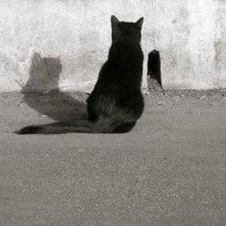

Slide 39
Aristotle understood an entity’s essence as a bundle of potentialities that become manifest over time. An entity’s essence acts as a kind of internal motor that impels the entity toward its fullest development, The oak tree, for example, is the final cause of an acorn, the end towards which it strives.

